Slide 1

College Management System
Komal Patel :300917418
Munira Negash Hussien: 301116861
Okafor Chiemelie: 301192703
Maxmilian Afanga Agwo Tekeh: 301325202

Slide 2
Problem Statement
A college management system serves as a platform for efficiently handling information and data related to students and staff.
The goal of the system is to streamline and automate various functions within a college, offering a seamless approach to managing all aspects. Additionally, it aims to generate detailed reports for the college's top management, providing comprehensive insights into various facets of the institution.

Slide 3
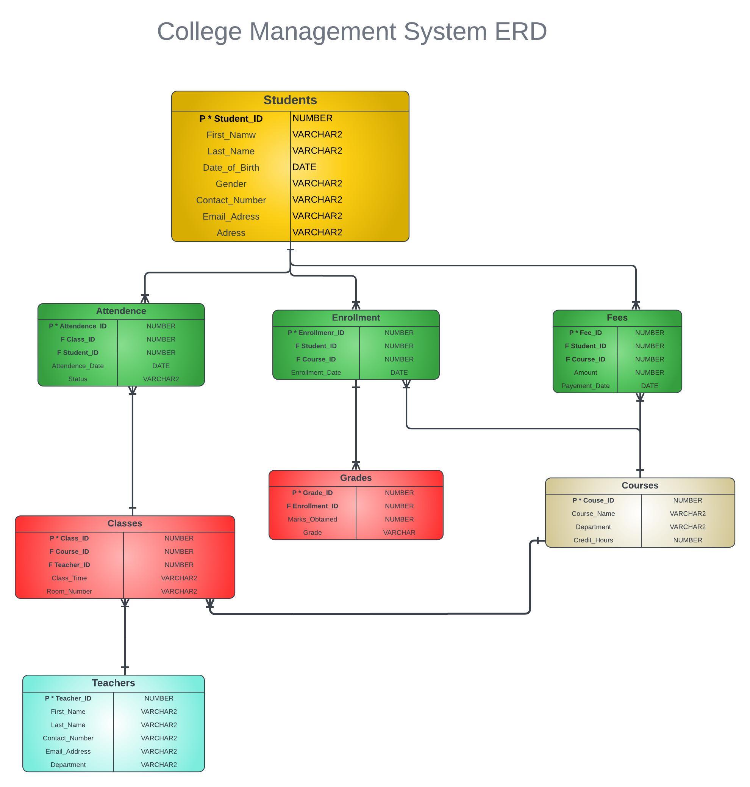
ERD

Slide 4
Tables
Students Table:
Student_ID (Primary Key)
First_Name
Last_Name
Date_of_Birth
Gender
Contact_Number
Email_Address
Address
Courses Table:
Course_ID (Primary Key)
Course_Name
Department
Credit_Hours

Slide 5
Tables
Enrollment Table:
Enrollment_ID (Primary Key)
Student_ID (Foreign Key referencing Students Table)
Course_ID (Foreign Key referencing Courses Table)
Enrollment_Date
Teachers Table:
Teacher_ID (Primary Key)
First_Name
Last_Name
Contact_Number
Email_Address
Department

Slide 6
Tables
Grades Table:
Grade_ID (Primary Key)
Enrollment_ID (Foreign Key referencing Enrollment Table)
Marks_Obtained
Grade
Classes Table:
Class_ID (Primary Key)
Course_ID (Foreign Key referencing Courses Table)
Teacher_ID (Foreign Key referencing Teachers Table)
Class_Time
Room_Number

Slide 7
Tables
Fees Table:
Fee_ID (Primary Key)
Student_ID (Foreign Key referencing Students Table)
Course_ID (Foreign Key referencing Courses Table)
Amount
Payment_Date
Attendance Table:
Attendance_ID (Primary Key)
Class_ID (Foreign Key referencing Classes Table)
Student_ID (Foreign Key referencing Students Table)
Attendance_Date
Status:(Enumeration:Present/Absent)

Slide 8
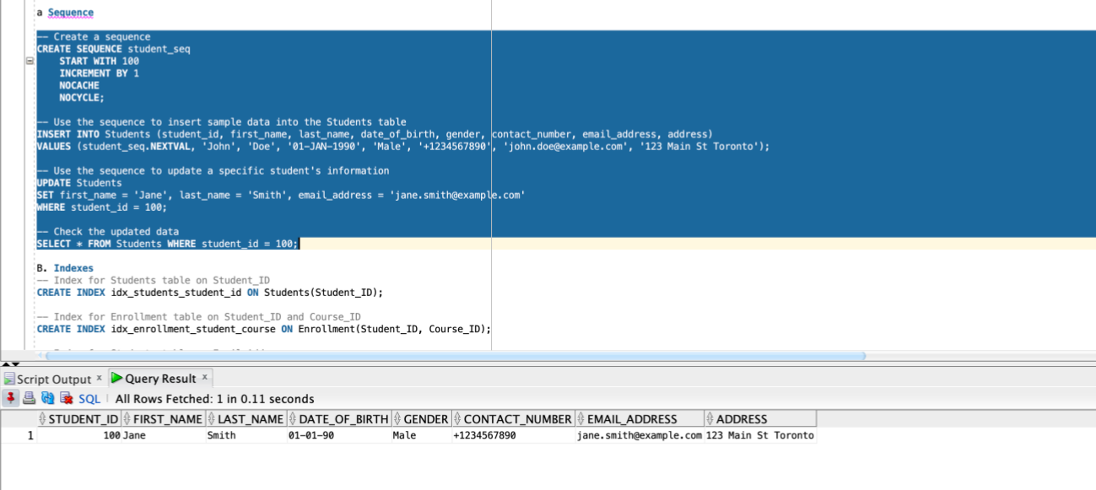
Sequence: Created to generate student_id

Slide 9
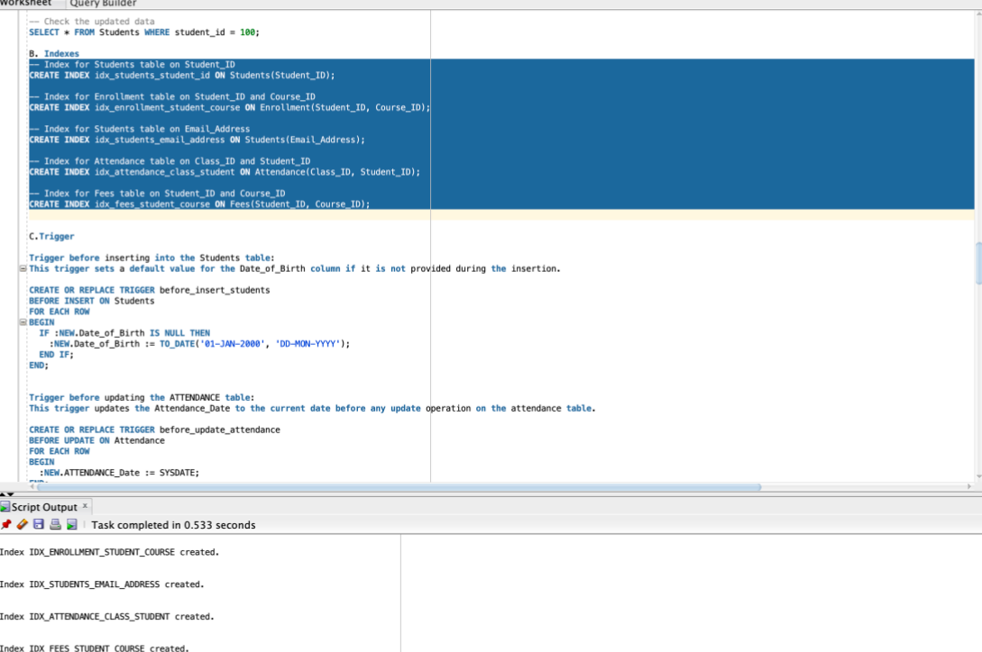
Index:

Slide 10
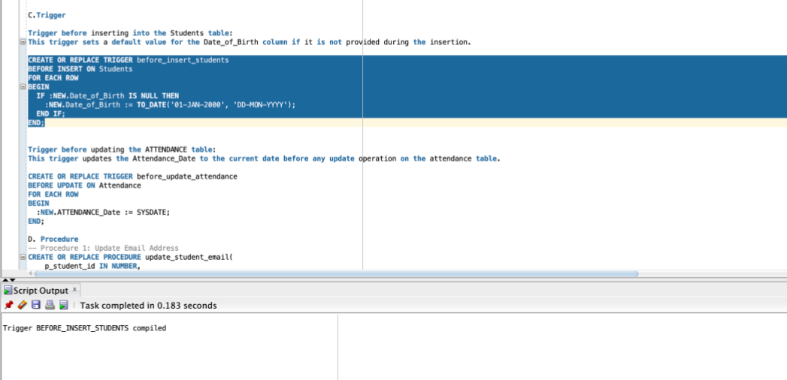
Triggers: This trigger sets a default value for the Date_of_Birth column if it is not provided during the insertion.

Slide 11
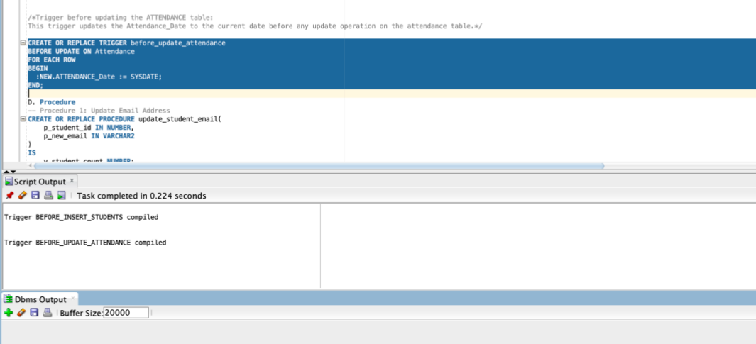
Trigger 2: This trigger updates the Attendance_Date to the current date before any update operation on the attendance table.

Slide 12
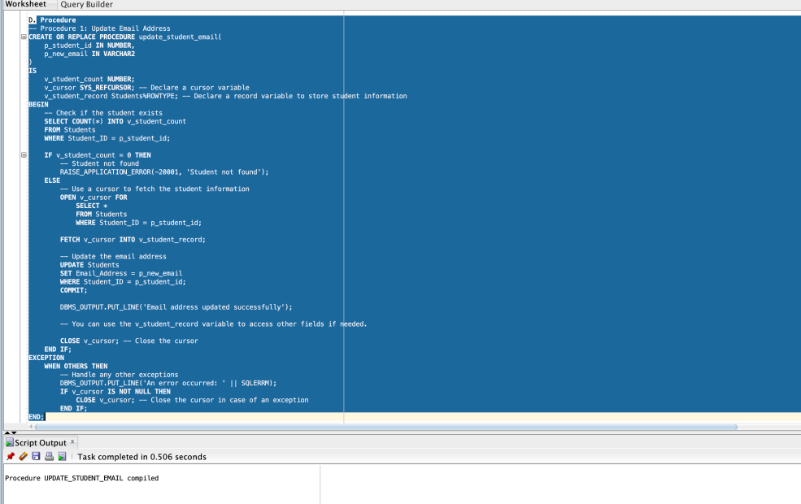
Procedure 1: To update an email

Slide 13
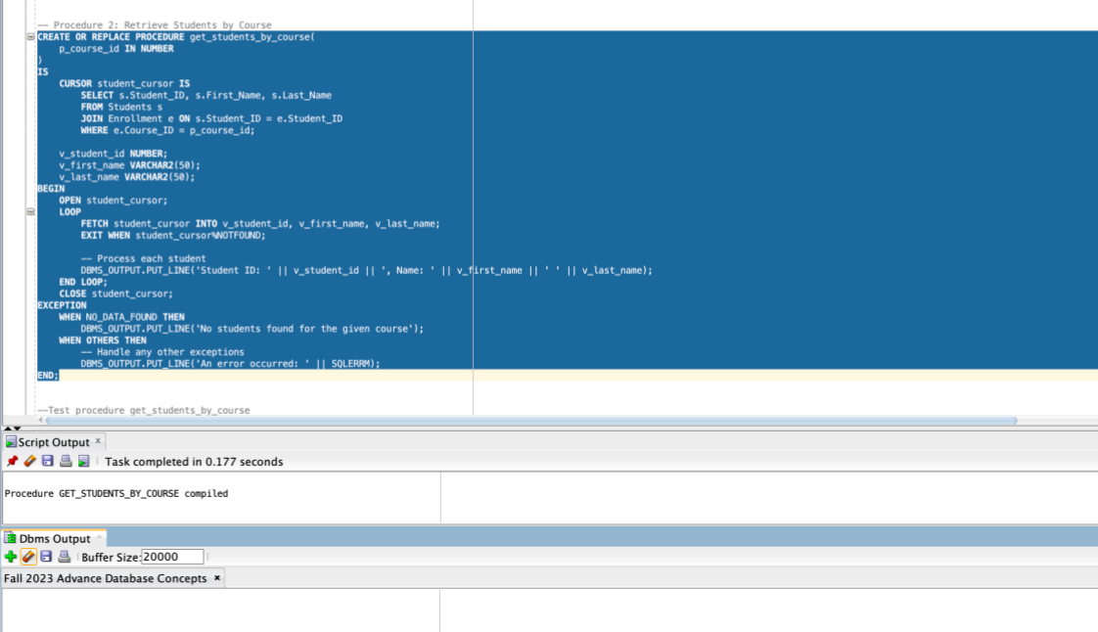
Procedure 2: To retrieve Student Information

Slide 14
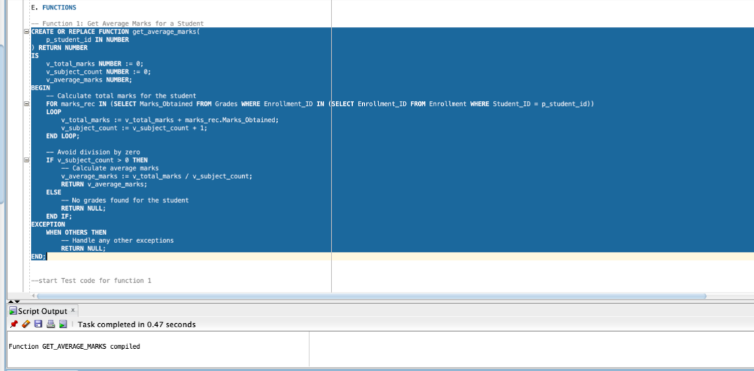
Function 1: Get Average marks of Student

Slide 15
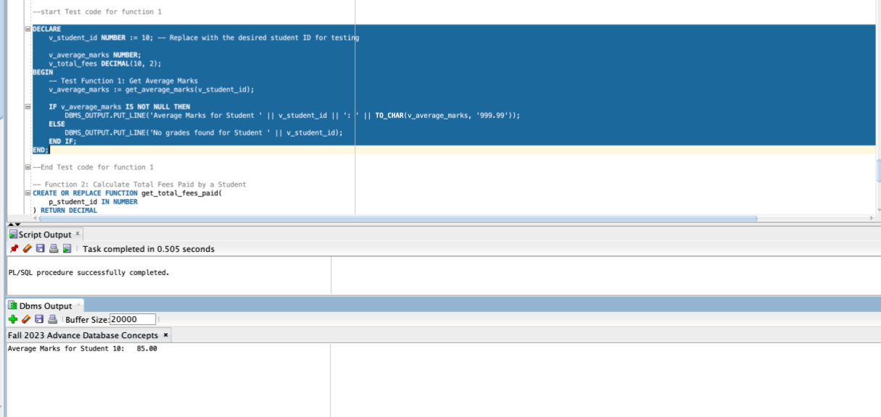
Test code Function 1:

Slide 16
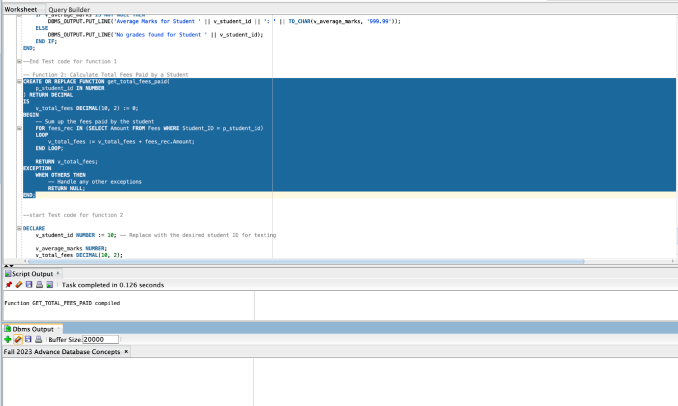
Function 2: Calculate Total Fees:

Slide 17
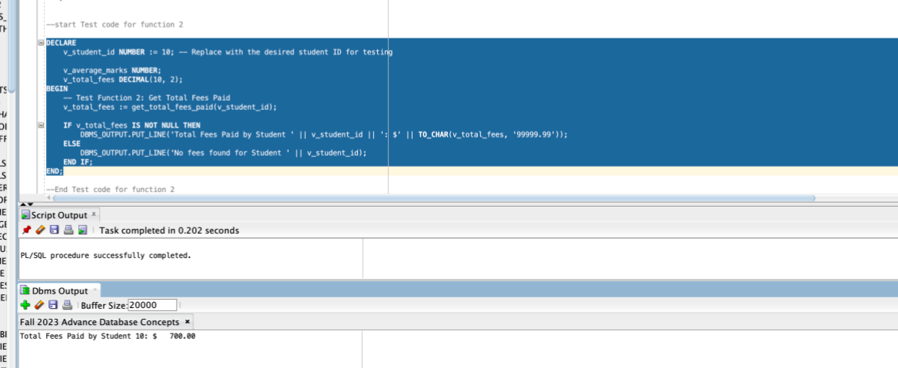
Test code Function 2 :

Slide 18
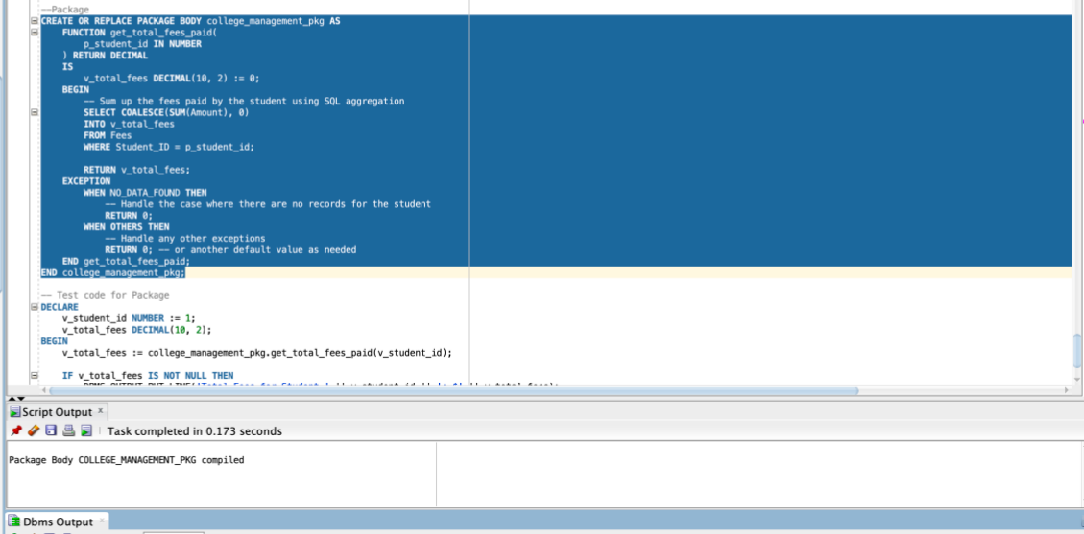
Package: college_management_pkg

Slide 19
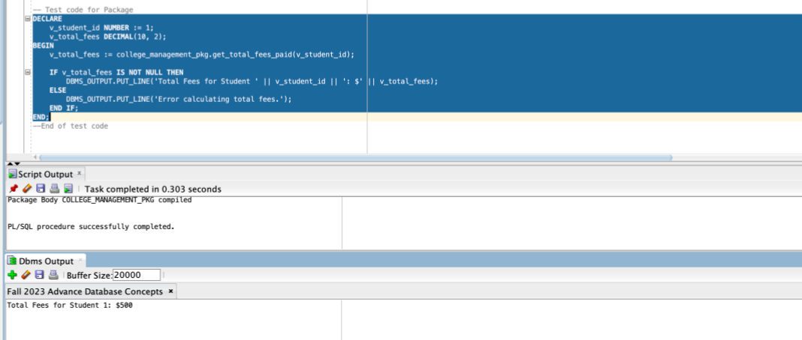
Package:Test code

